Slide 2
Then…

Slide 3
Prior to the introduction of the Penguin Ice Ladder, certain dive techniques have been used for years. Some of these mentioned techniques, although very archaic, have never been changed. Ice diving, being an inherently dangerous activity, needed improvement.

Slide 4
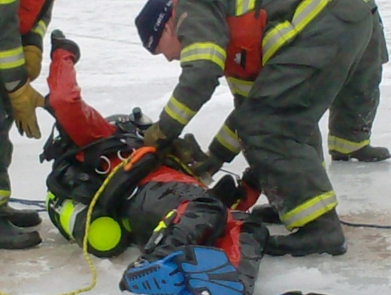
Safety should be the #1 priority.

Slide 5
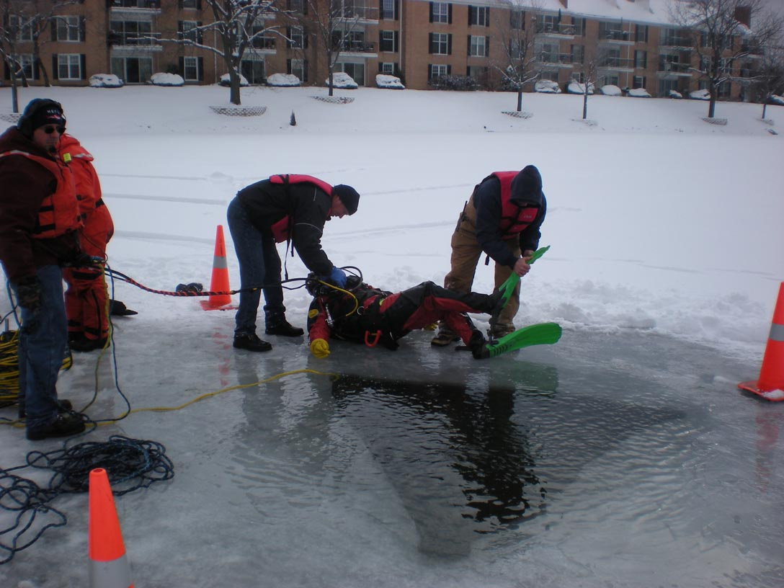
Injuries do not discriminate.

Slide 6
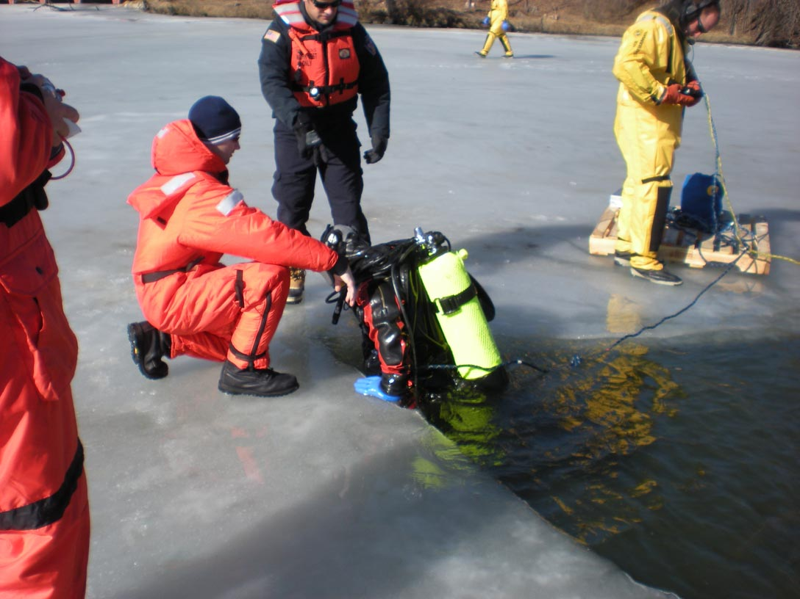
Whether it is an actual incident….

Slide 7
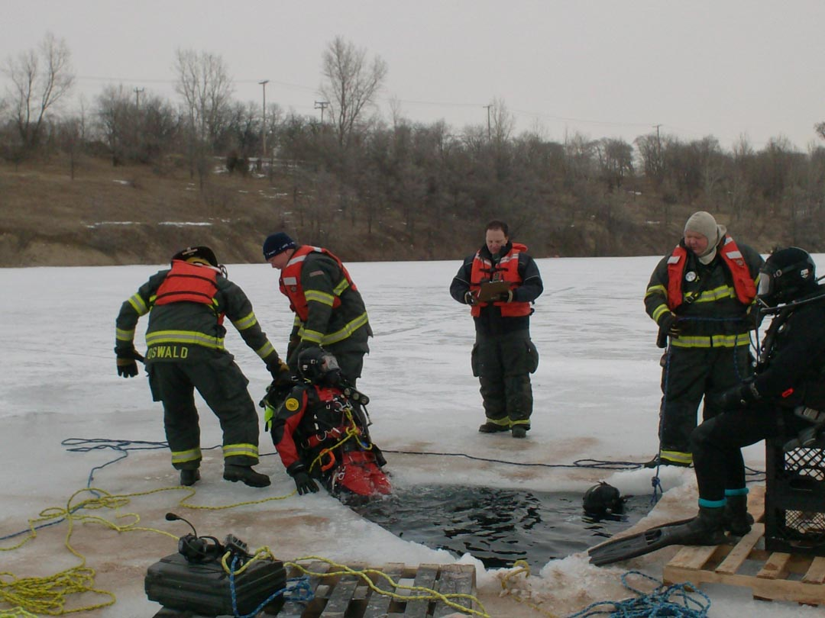
…or a training exercise.

Slide 8
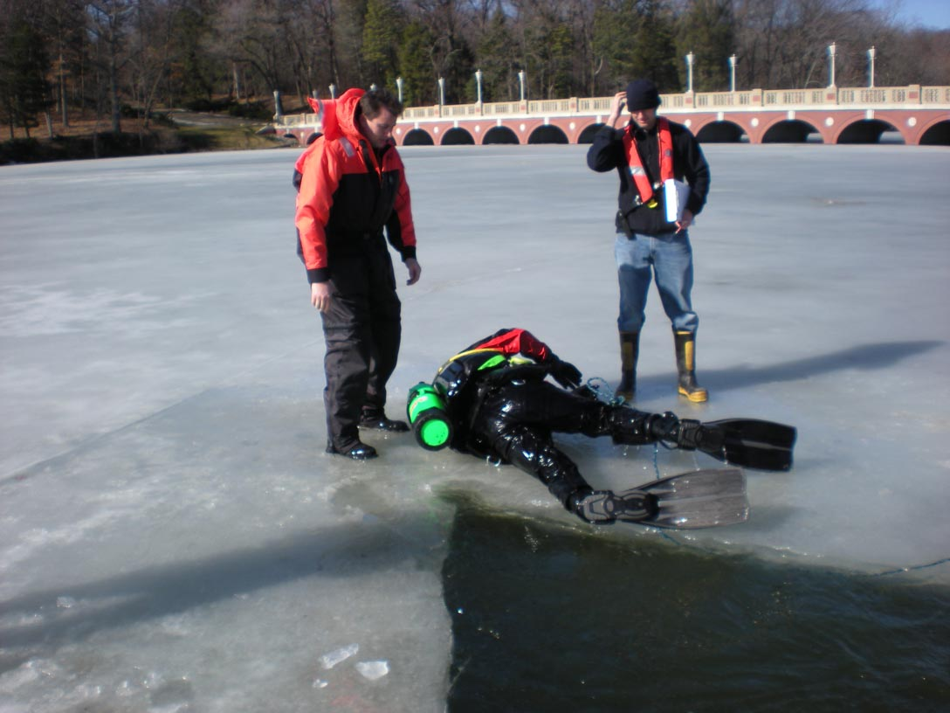
Roughly 48% of injuries are strains and sprains.

Slide 9
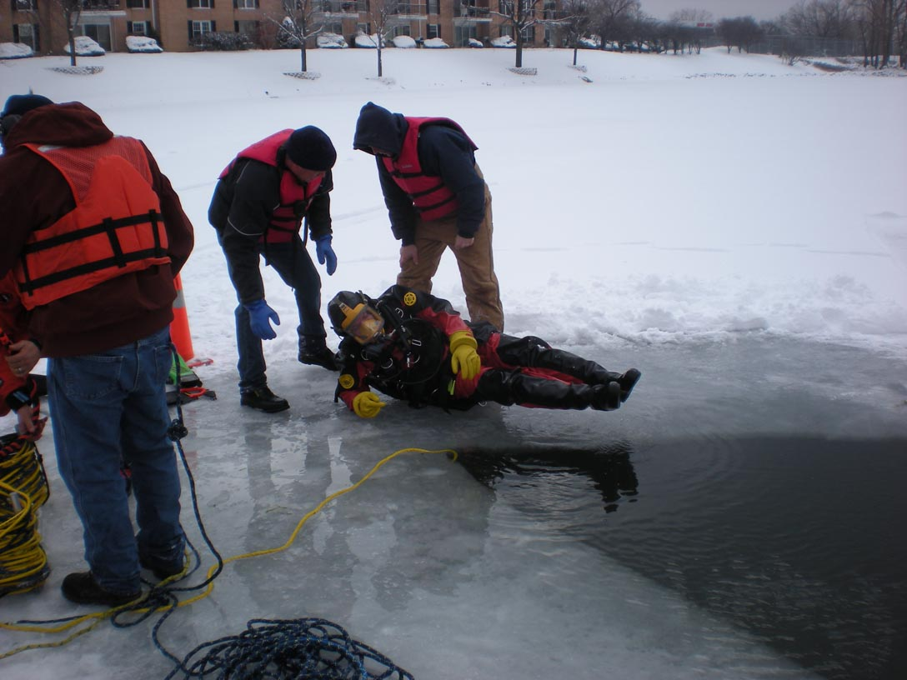
Dangerous conditions can lead to….

Slide 10
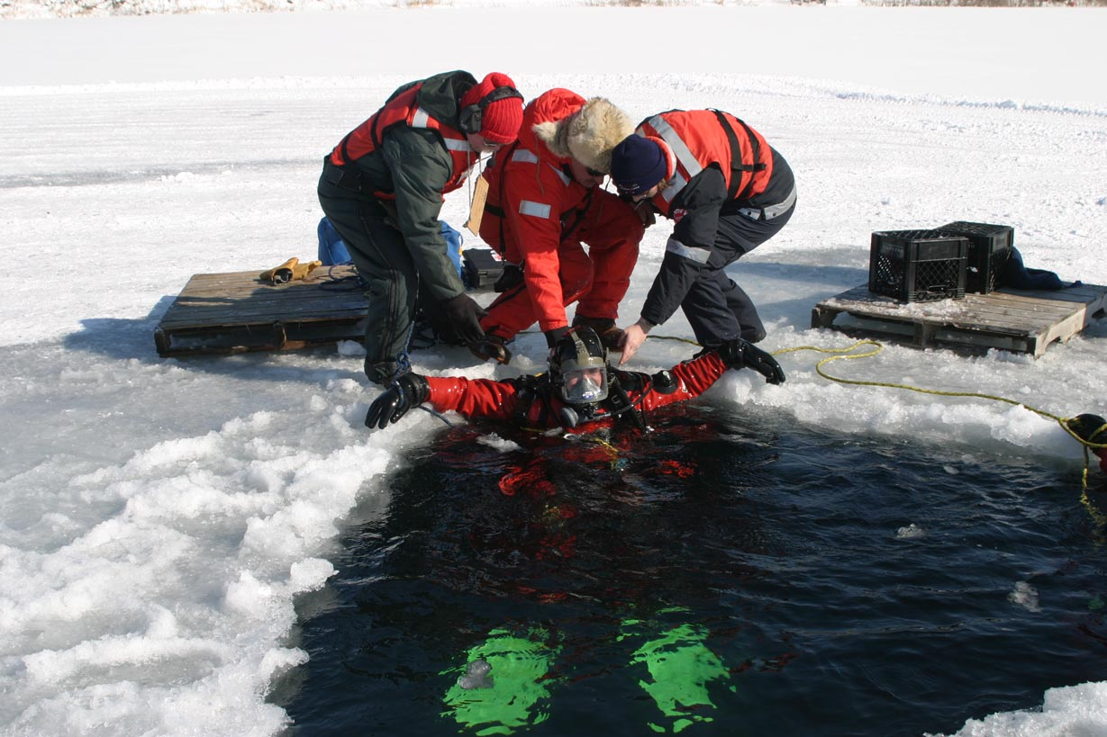
Equipment Damage

Slide 11
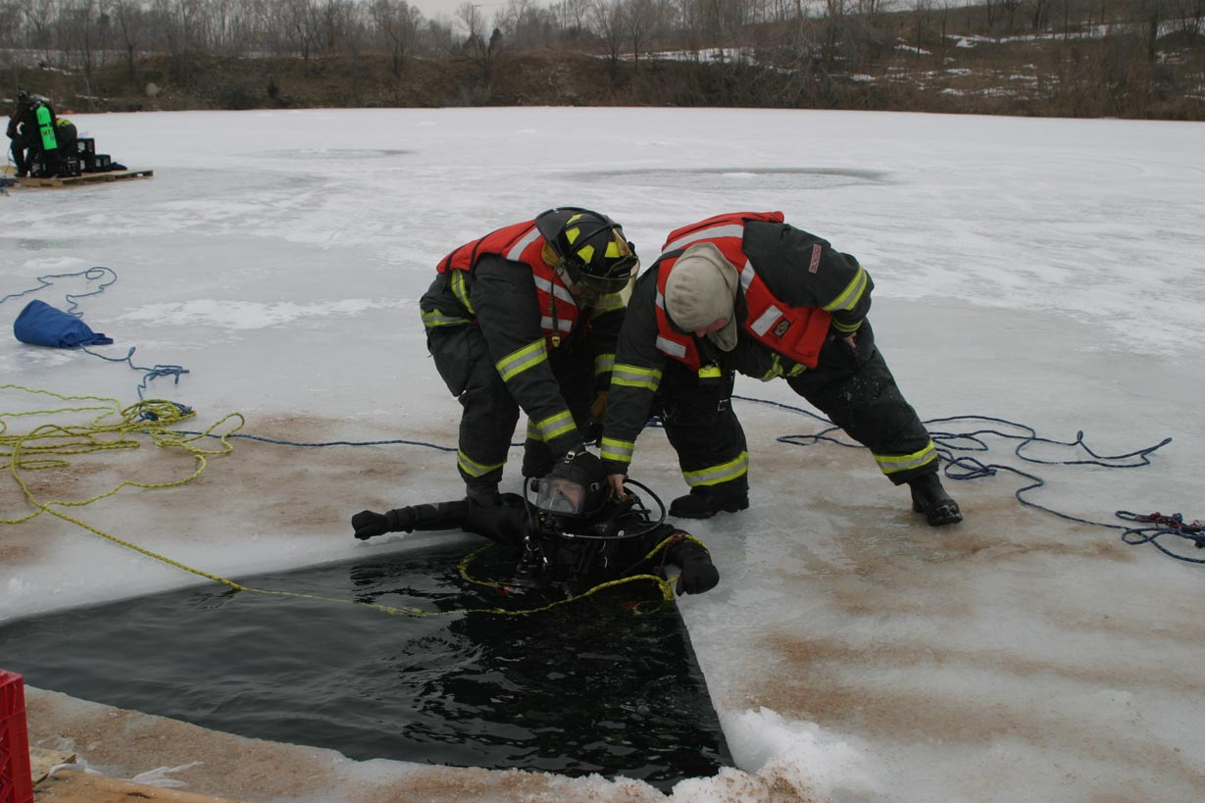
Back and Knee Injuries

Slide 12
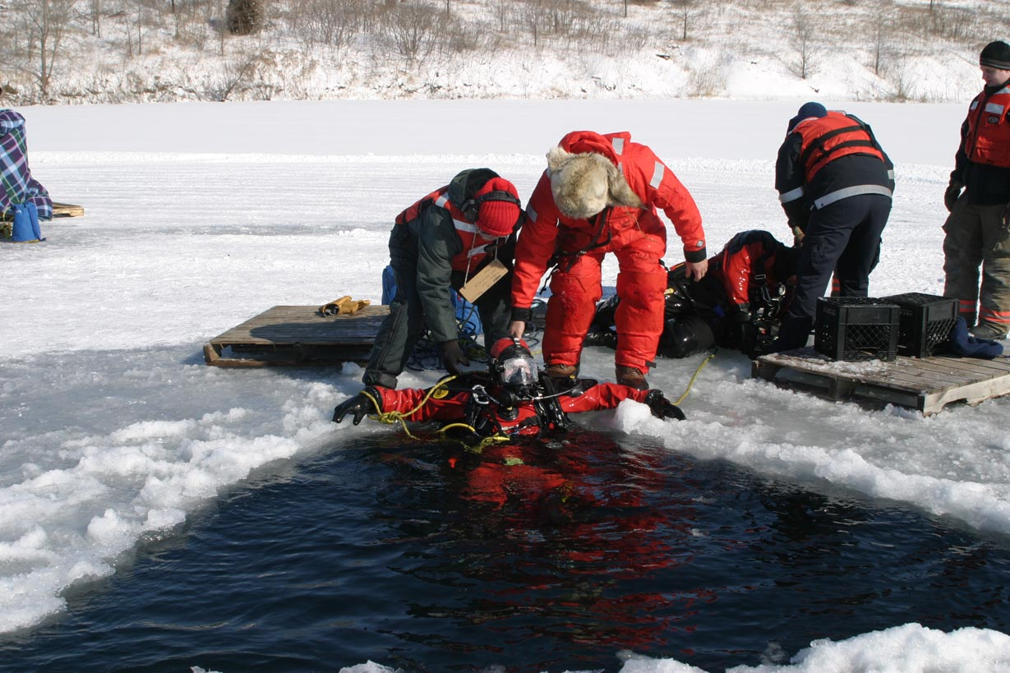
And worst case….DEATH.

Slide 13
Injuries can lead to increased costs due to:
Time Off
Overtime
Medical Bills
Legal Expenses
Long Term Disability
Unemployment
Insurance Expenses
Additional Staffing for Employee Replacement

Slide 14
Now!!!

Slide 15
The

Slide 16
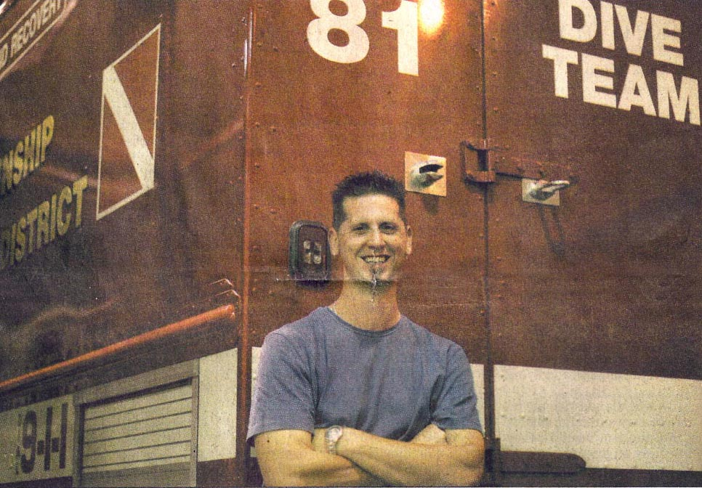
My name is Chris Smith and I am the inventor of the Penguin Ice Ladder. I am a member of the McHenry Township Fire Protection District in McHenry, Illinois. I have been with the department for 12 years and part of the dive team for 9 years. After becoming an ice diver, I realized there was a flaw in the way we exited the water. I went to the drawing board and started developing a better way. The Penguin Ice Ladder.
Chris Smith

Slide 17
The Penguin Ice Ladder is revolutionizing the way dive operations are conducted. It keeps divers and support team/staff safe and healthy.

Slide 18
Reviews and articles on the Penguin Ice Ladder can be seen in these popular publications.
Fire Rescue Magazine
Fire Engineering Magazine
Fire Chief Magazine
Technical Rescue Magazine

Slide 19
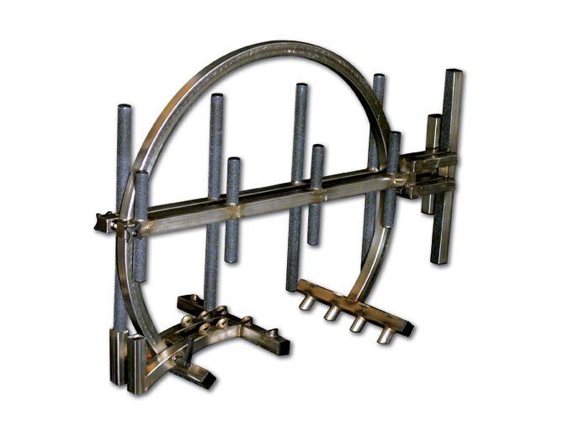
Low Cost of Ownership
Over the life of the Penguin Ice Ladder, the cost is pennies per day.

Slide 20
Easy To Maintain and Use
The Penguin Ice Ladder is constructed out of 316L Stainless Steel.

Slide 21
Easy To Maintain and Use
The Penguin Ice Ladder is constructed out of 316L Stainless Steel.
316L being a marine grade stainless is used in many food and surgical applications.

Slide 22
Easy To Maintain and Use
There is very little care needed to maintain it for many years to come.

Slide 23
Easy To Maintain and Use
There is very little care needed to maintain it for many years to come.
Just rinse it off with fresh water and it is ready for its next deployment.

Slide 24
Specifications
Transport Mode:
Height - 35”
Length - 50“
Width - 18”
Weight - 63 lbs.

Slide 25
Specifications
Work Mode:
Ladder Height - 8’
Ice Thickness
2” to 22”
Pier Attachable
Using included rubber
pier pads.
Boat Applications
Customized brackets.

Slide 26
Quick Set-up
Easy to carry.

Slide 27
Quick Set-up
Easy to carry.
Establish location.

Slide 28
Quick Set-up
Easy to carry.
Establish location.
Loosen lock nut.

Slide 29
Quick Set-up
Easy to carry.
Establish location.
Loosen lock nut.
Remove ladder from circle.

Slide 30
Quick Set-up
Easy to carry.
Establish location.
Loosen lock nut.
Remove ladder from circle.
Loosen T-Lock to lock to ice.

Slide 31
Quick Set-up
Easy to carry.
Establish location.
Loosen lock nut.
Remove ladder from circle.
Loosen T-Lock to lock to ice.
Insert circle into water around ice.

Slide 32
Quick Set-up
Easy to carry.
Establish location.
Loosen lock nut.
Remove ladder from circle.
Loosen T-Lock to lock to ice.
Insert circle into water around ice.
Adjust circle to ice thickness.

Slide 33
Quick Set-up
Easy to carry.
Establish location.
Loosen lock nut.
Remove ladder from circle.
Loosen T-Lock to lock to ice.
Insert circle into water around ice.
Adjust circle to ice thickness.
Secure circle to ice.

Slide 34
Quick Set-up
Easy to carry.
Establish location.
Loosen lock nut.
Remove ladder from circle.
Loosen T-Lock to lock to ice.
Insert circle into water around ice.
Adjust circle to ice thickness.
Secure circle to ice.
Insert ladder.

Slide 35
Quick Set-up
Easy to carry.
Establish location.
Loosen lock nut.
Remove ladder from circle.
Loosen T-Lock to lock to ice.
Insert circle into water around ice.
Adjust circle to ice thickness.
Secure circle to ice.
Insert ladder.
Unfold ladder.

Slide 36
Quick Set-up
Easy to carry.
Establish location.
Loosen lock nut.
Remove ladder from circle.
Loosen T-Lock to lock to ice.
Insert circle into water around ice.
Adjust circle to ice thickness.
Secure circle to ice.
Insert ladder.
Unfold ladder.
Approach ladder.

Slide 37
Quick Set-up
Easy to carry.
Establish location.
Loosen lock nut.
Remove ladder from circle.
Loosen T-Lock to lock to ice.
Insert circle into water around ice.
Adjust circle to ice thickness.
Secure circle to ice.
Insert ladder.
Unfold ladder.
Approach ladder.
Exit water.

Slide 38
Quick Set-up
Easy to carry.
Establish location.
Loosen lock nut.
Remove ladder from circle.
Loosen T-Lock to lock to ice.
Insert circle into water around ice.
Adjust circle to ice thickness.
Secure circle to ice.
Insert ladder.
Unfold ladder.
Approach ladder.
Exit water.
Break down ladder when finished.

Slide 39
Quick Set-up
Easy to carry.
Establish location.
Loosen lock nut.
Remove ladder from circle.
Loosen T-Lock to lock to ice.
Insert circle into water around ice.
Adjust circle to ice thickness.
Secure circle to ice.
Insert ladder.
Unfold ladder.
Approach ladder.
Exit water.
Reattach ladder to circle for transport.
Ladder is broken down and
set up easily in 5 minutes
or less with one person.

Slide 40
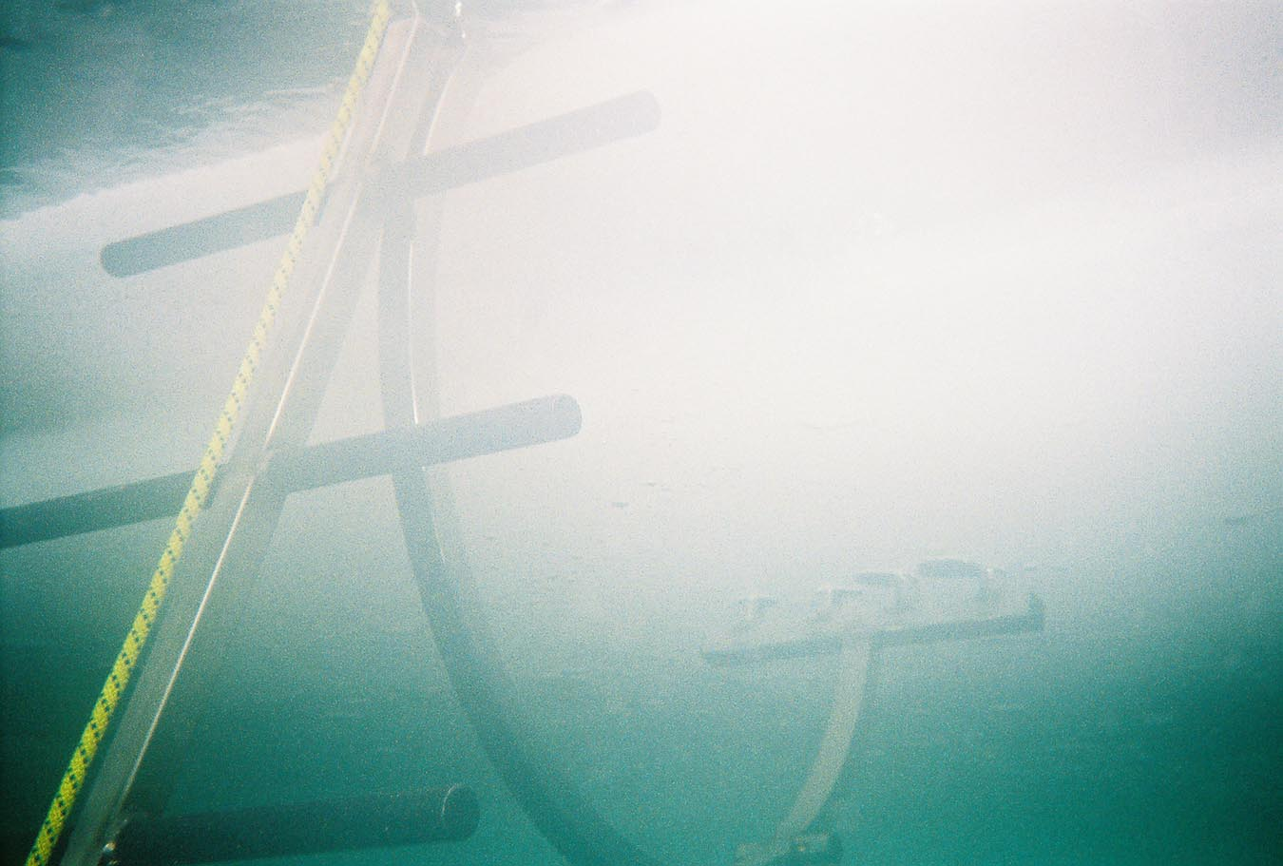
Versatility – Ice Operations
Attaches to 2” to 22”of ice.
Greater thicknesses an can achieved with larger circle.

Slide 41
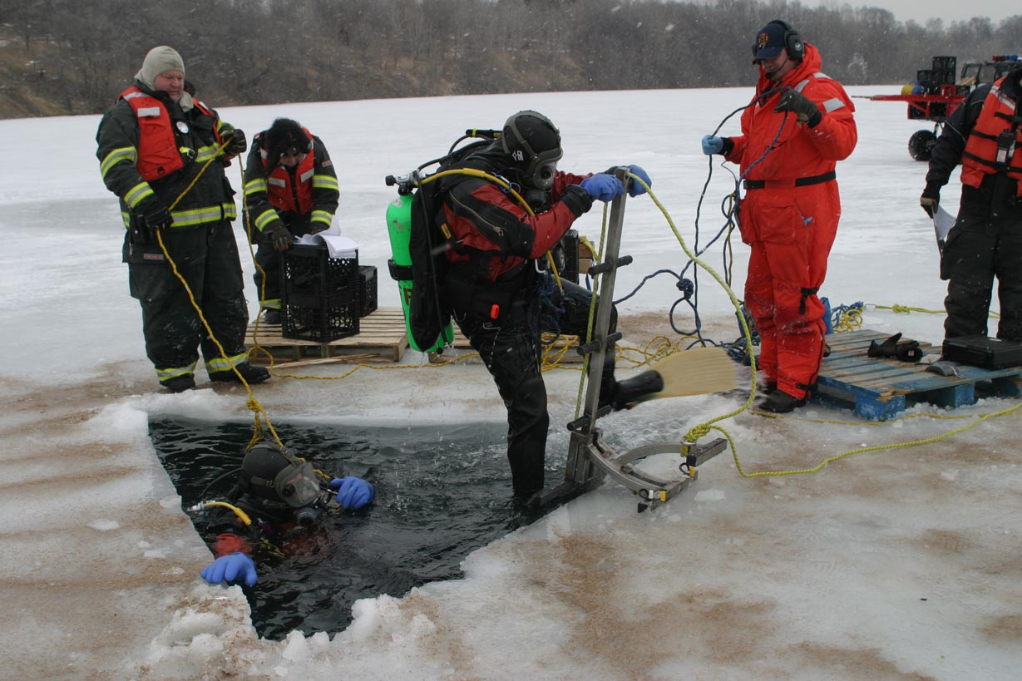
Versatility – Ice Operations
Attaches to 2” to 22”of ice.
Greater thicknesses an can achieved with larger circle.
Allows diver to exit water fully dressed with fins.

Slide 42
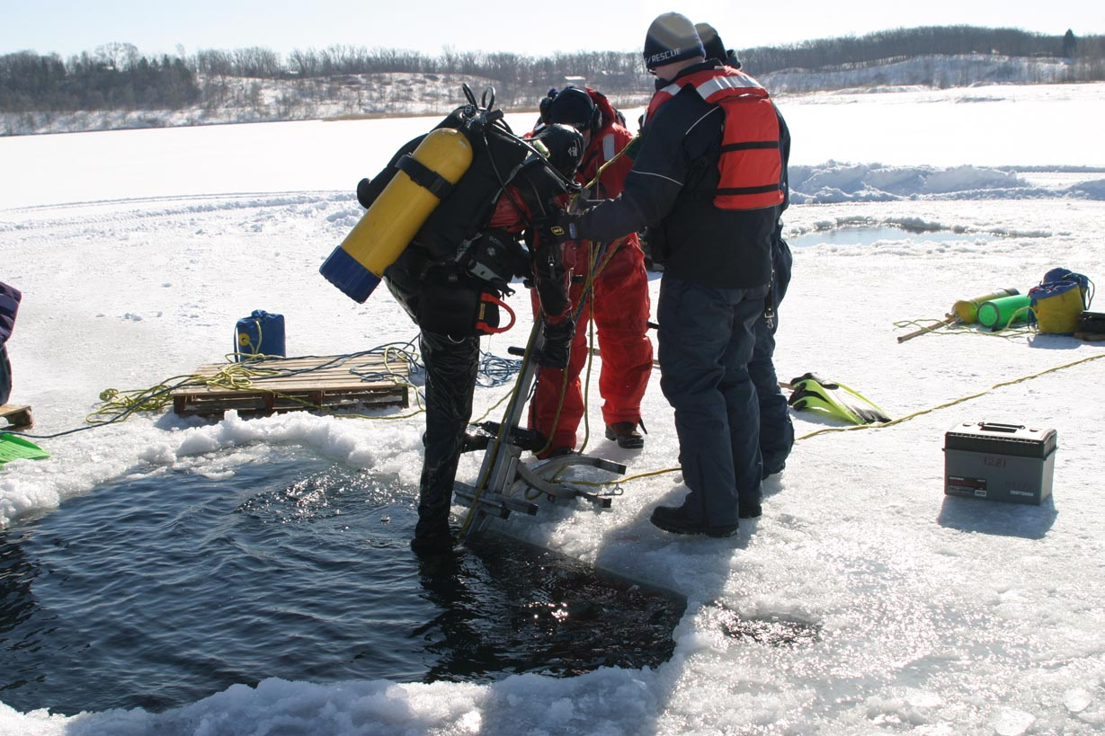
Versatility – Ice Operations
Attaches to 2” to 22”of ice.
Greater thicknesses an can achieved with larger circle.
Allows diver to exit water fully dressed with fins.
Reduces support staff injuries due to slips and falls.

Slide 43
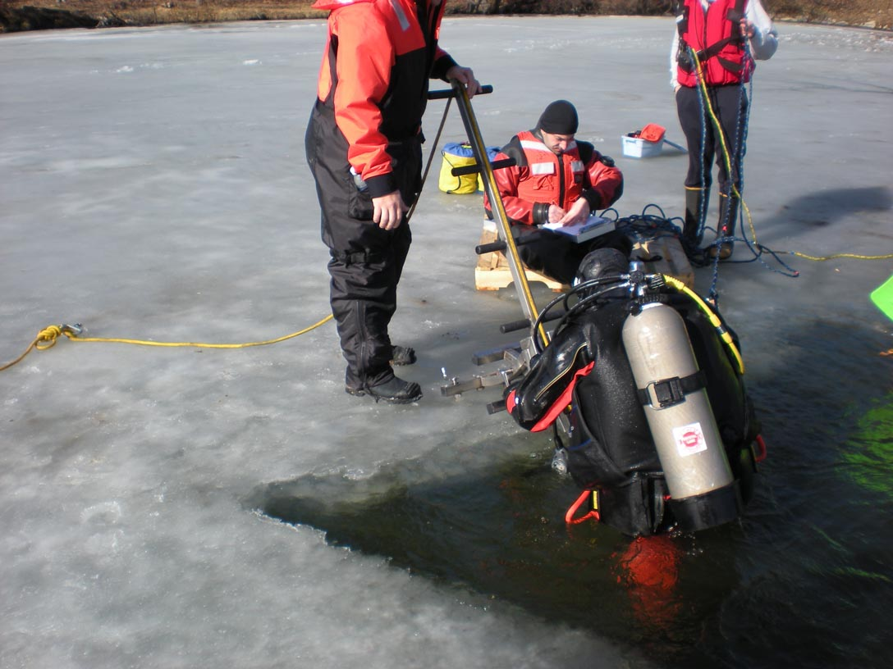
Versatility – Ice Operations
Attaches to 2” to 22”of ice.
Greater thicknesses an can achieved with larger circle.
Allows diver to exit water fully dressed with fins.
Reduces support staff injuries due to slips and falls.
Reduces the number of support staff needed. Especially on poor ice conditions.

Slide 44
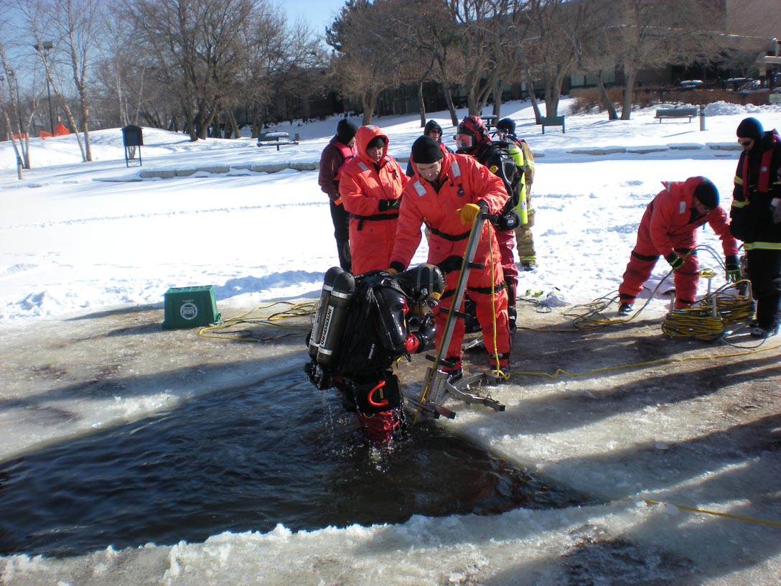
Versatility – Ice Operations
Reduces wear and tear on gear by eliminating being dragged out of the water.

Slide 45
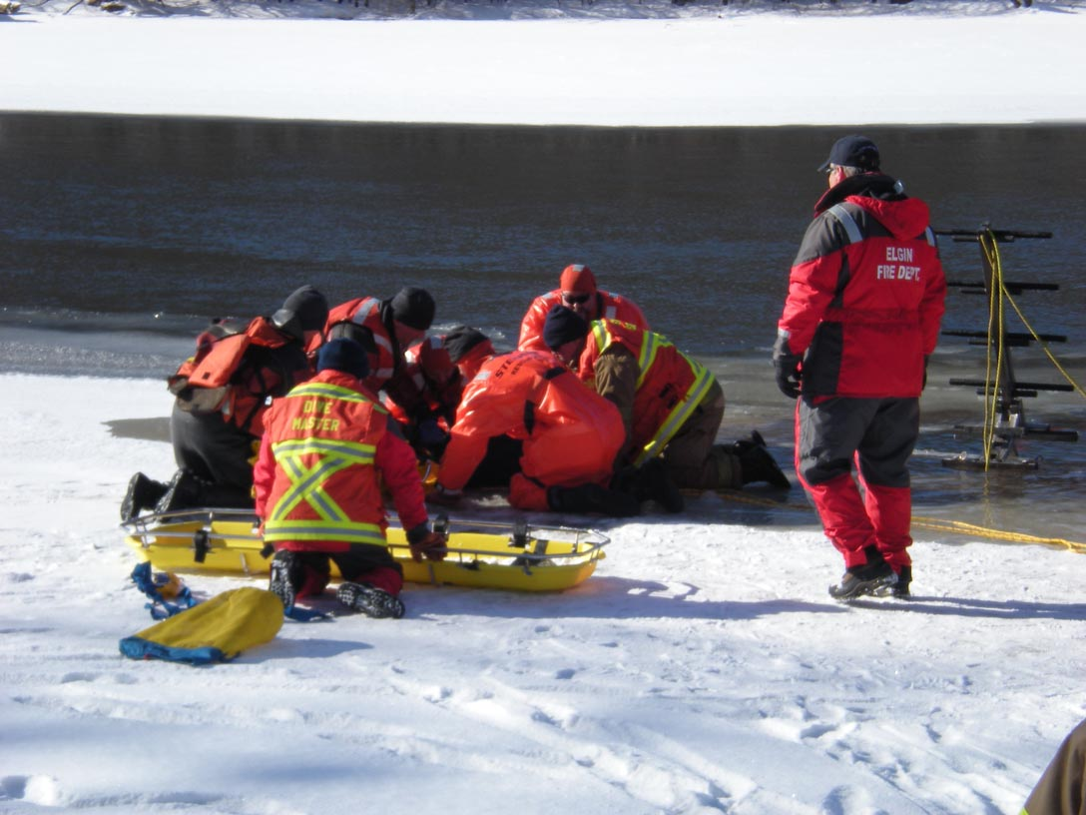
Versatility – Ice Operations
Reduces wear and tear on gear by eliminating being dragged out of the water.
Aides in rescue and/or recovery of a victim.

Slide 46
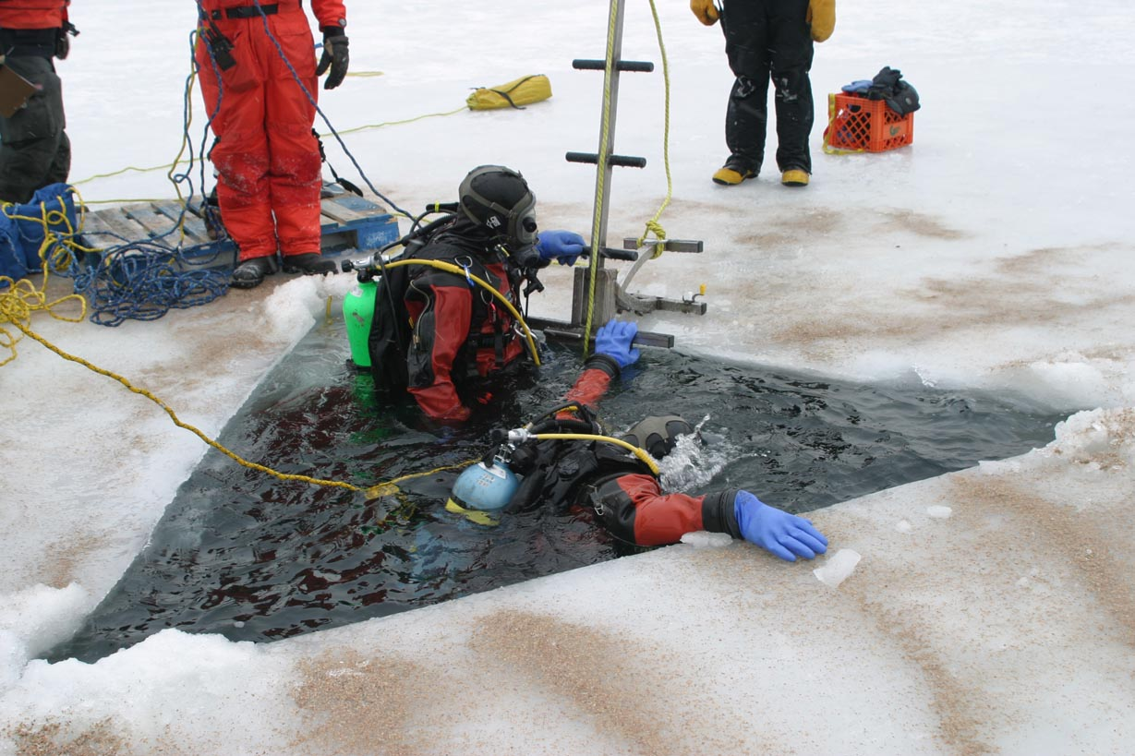
Versatility – Ice Operations
Reduces wear and tear on gear by eliminating being dragged out of the water.
Aides in rescue and/or recovery of a victim.
Allows diver to rest and conserve energy prior to and after a dive.

Slide 47
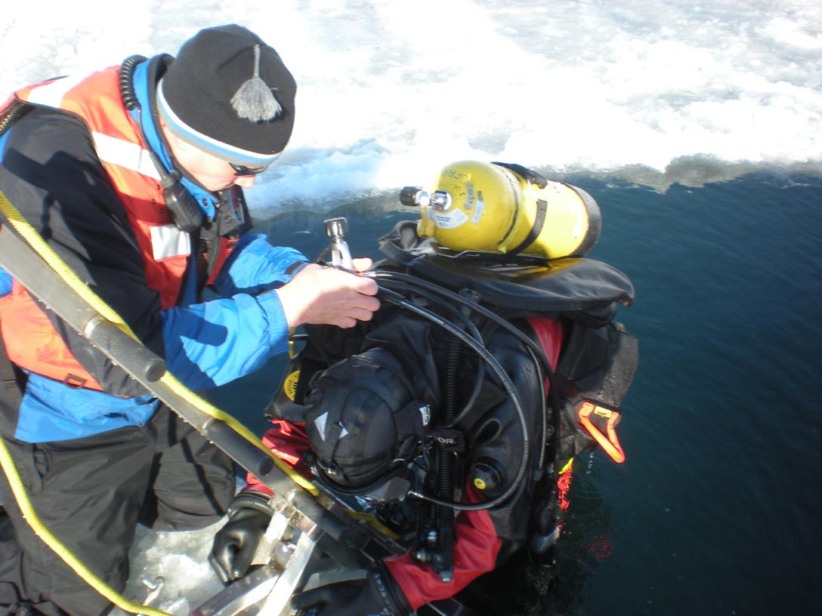
Versatility – Ice Operations
Reduces wear and tear on gear by eliminating being dragged out of the water.
Aides in rescue and recovery of victim.
Allows diver to rest and conserve energy prior to and after a dive.
Allows for repairs and adjustments due to cold conditions.

Slide 48
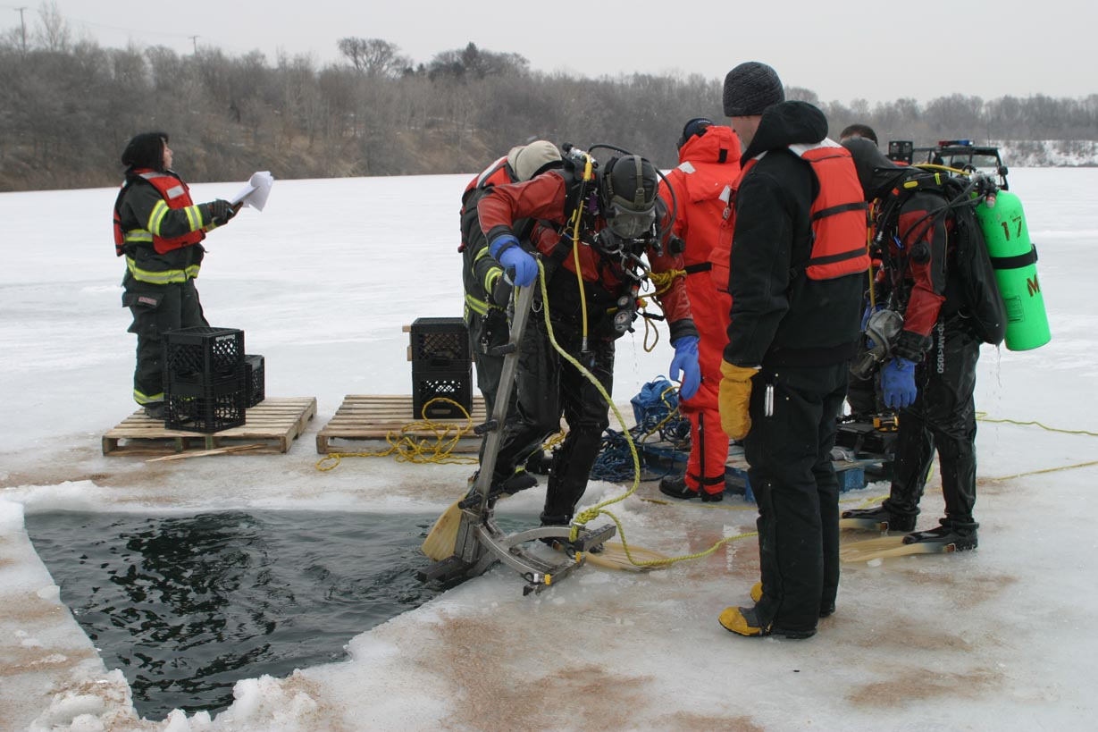
Versatility – Ice Operations
Streamlines operation by getting divers out quickly.

Slide 49
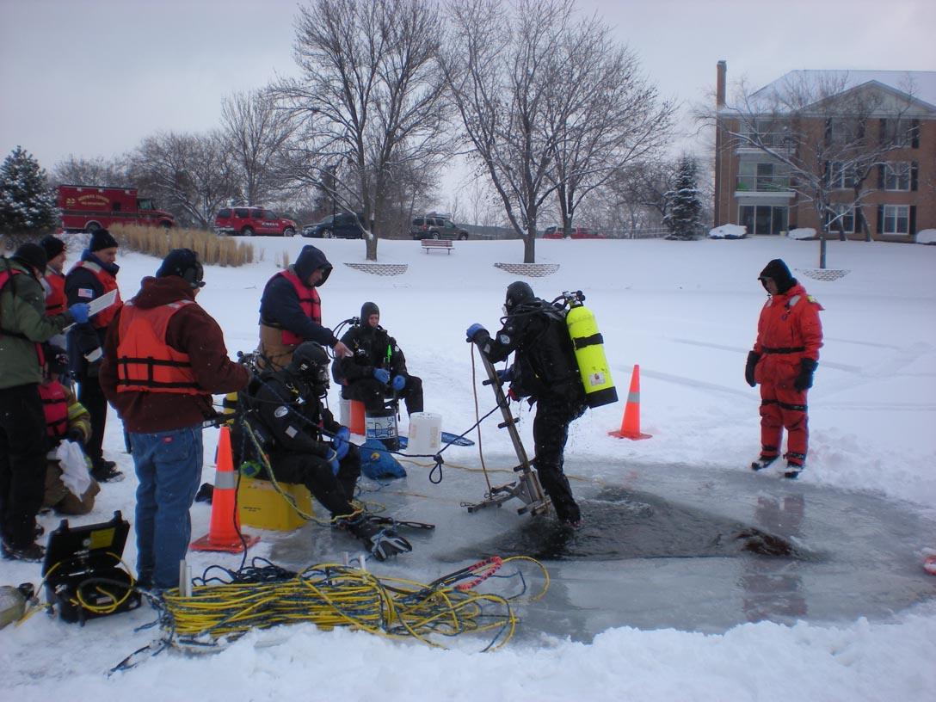
Versatility – Ice Operations
Streamlines operation by getting divers out quickly.
Can be set up in small ice opening.

Slide 50
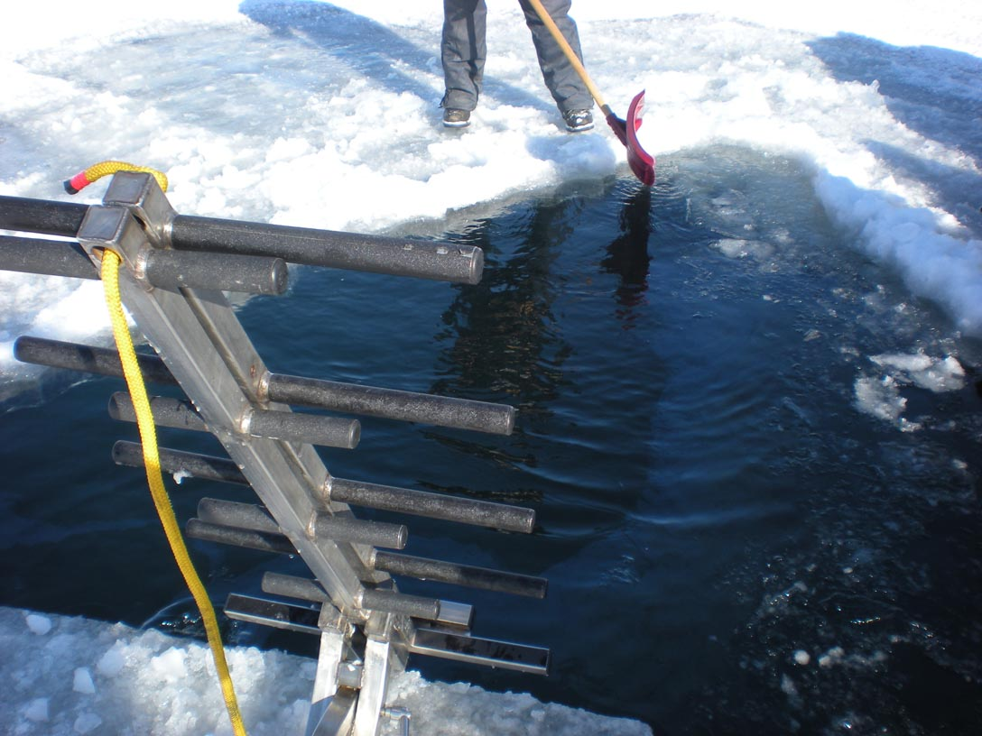
Versatility – Ice Operations
Streamlines operation by getting divers out quickly.
Can be set up in small ice opening.
Ladder in the folded position does not interfere with rope patterns.

Slide 51
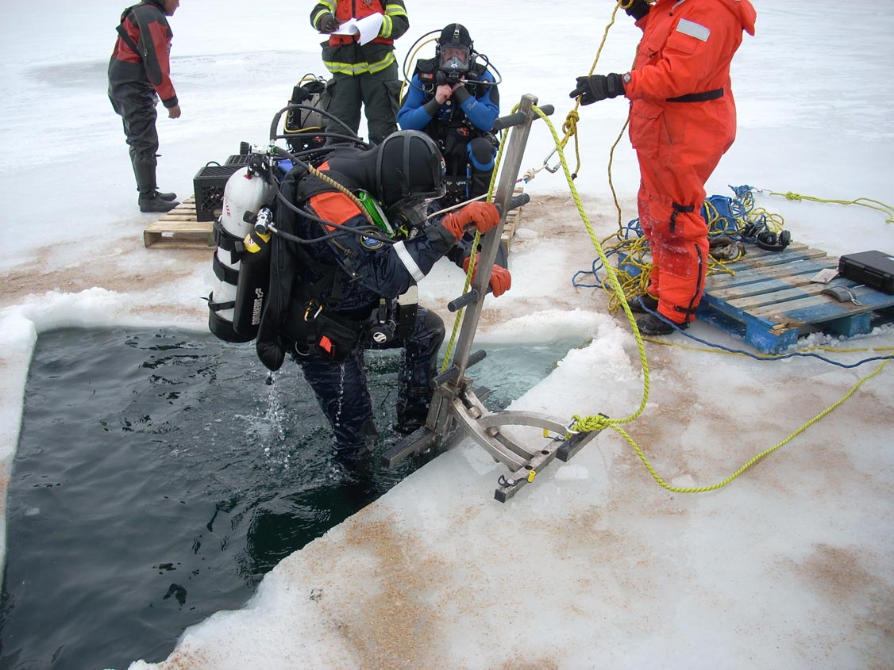
Versatility – Ice Operations
Streamlines operation by getting divers out quickly.
Can be set up in small ice opening.
Ladder in the folded position does not interfere with rope patterns.
Safety and risk reduction makes the Penguin Ice Ladder an invaluable tool.

Slide 52
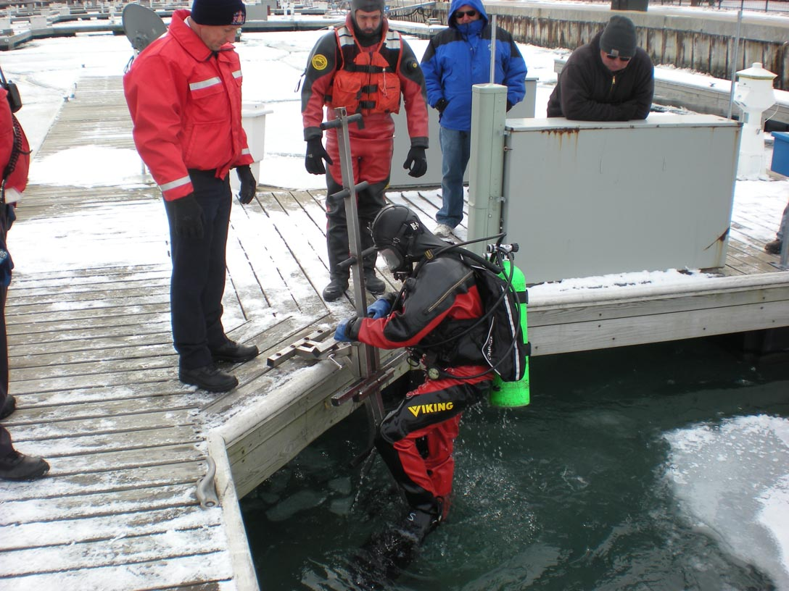
Versatility – Pier Operations
With the addition of the included rubber pier pads the Penguin Ice Ladder can be used on piers and docks.

Slide 53
Versatility – Pier Operations
With the addition of the included rubber pier pads the Penguin Ice Ladder can be used on piers and docks.
Rubber pier pads protect the pier or dock from damage. They also protect the ice spikes on the ladder itself.

Slide 54
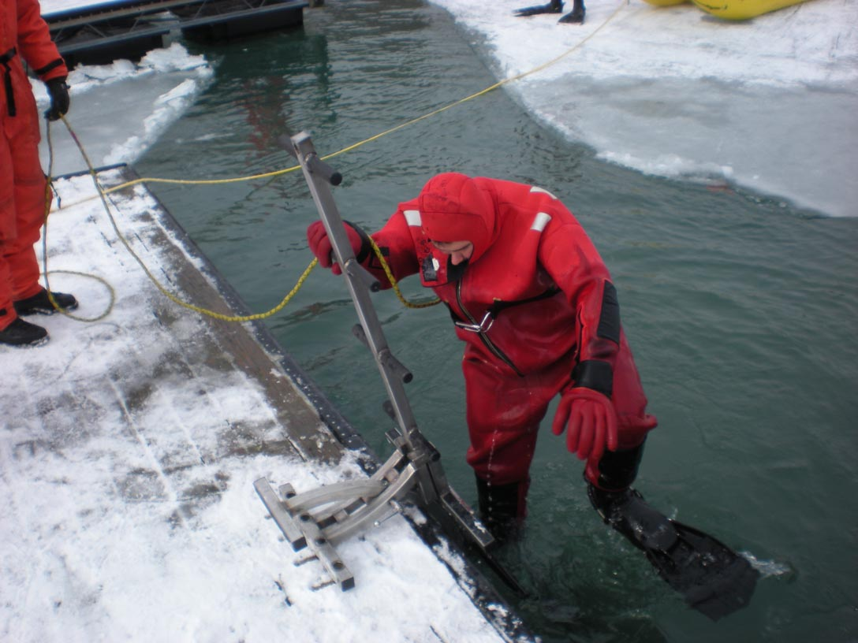
Versatility – Pier Operations
With the addition of the included rubber pier pads the Penguin Ice Ladder can be used on piers and docks.
Rubber pier pads protect the pier or dock from damage. They also protect the ice spikes on the ladder itself.
The rubber pier pads make the Penguin Ice Ladder useable year round.

Slide 55
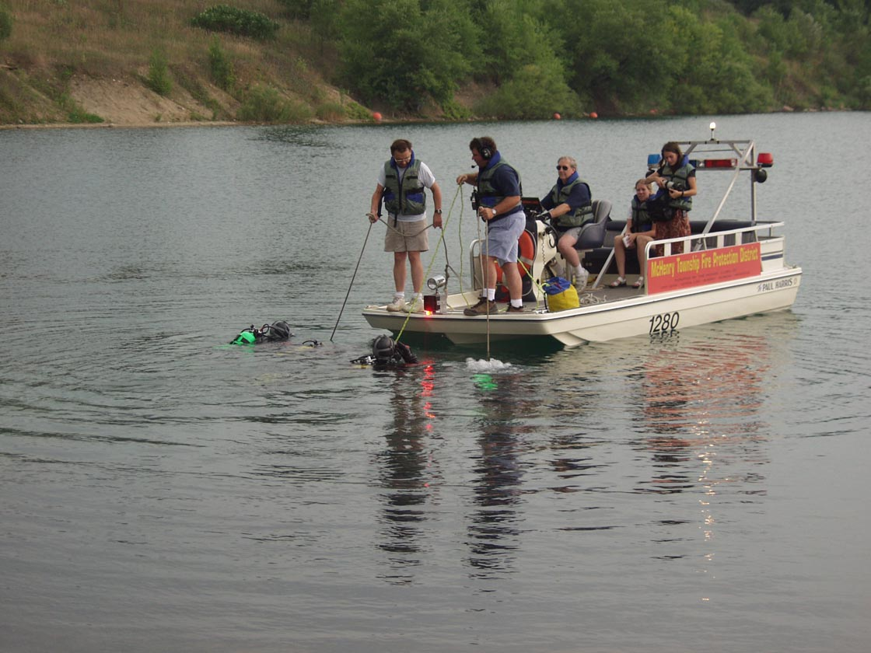
Versatility – Boat Operations
Customizable boat brackets are made to each specific boat application.
Adding a bracket to a boat extends the versatility of the Penguin Ice Ladder.

Slide 56
Testimonials
“Under extreme circumstances the Penguin Ice Ladder made entry and exit of the diver a breeze. We were operating on a river with current, in an ice dive situation. Using sonar, targets were identified with multiple holes being cut for diver access. The Penguin ladder system allowed easy access with limited effort by the diver without the need for additional support personnel to aid in diver removal. This was a key factor in the mission success; the ice was rather thin and more support member would have over weighted the ice shelf. This was the one incident that the ladder proved itself outside of the training ground. In the future I will make sure we have a Penguin Ice Ladder at our incidents.”
^{Todd Rishling, PSSI}
^{Water Rescue Team Leader}
^{18 Years of Service}
“Had it not been for the ice ladder the day of our dive training, we would have had to cancel. We were limited on surface help which would have made it impossible to get divers out of the hole. The ladder took minimal time to set up and was just what we needed to make the dive a success. The ladder did not interfere with any rope patterns or dive operations. When it came time for divers to exit the water they were able to climb out fully geared up (including fins) under their own power with no assistance needed and little effort. The ladder was sturdy and never moved during the whole drill. After using the ladder, I realized there is no other way divers should have to be extracted from the water. It is not worth the risk of serious injury or safety to personnel assisting divers in or out of the water. The ladder is truly the answer!”
^{Lt. Chris Mann}
^{Divemaster}
^{20 Years of Service}

Slide 57
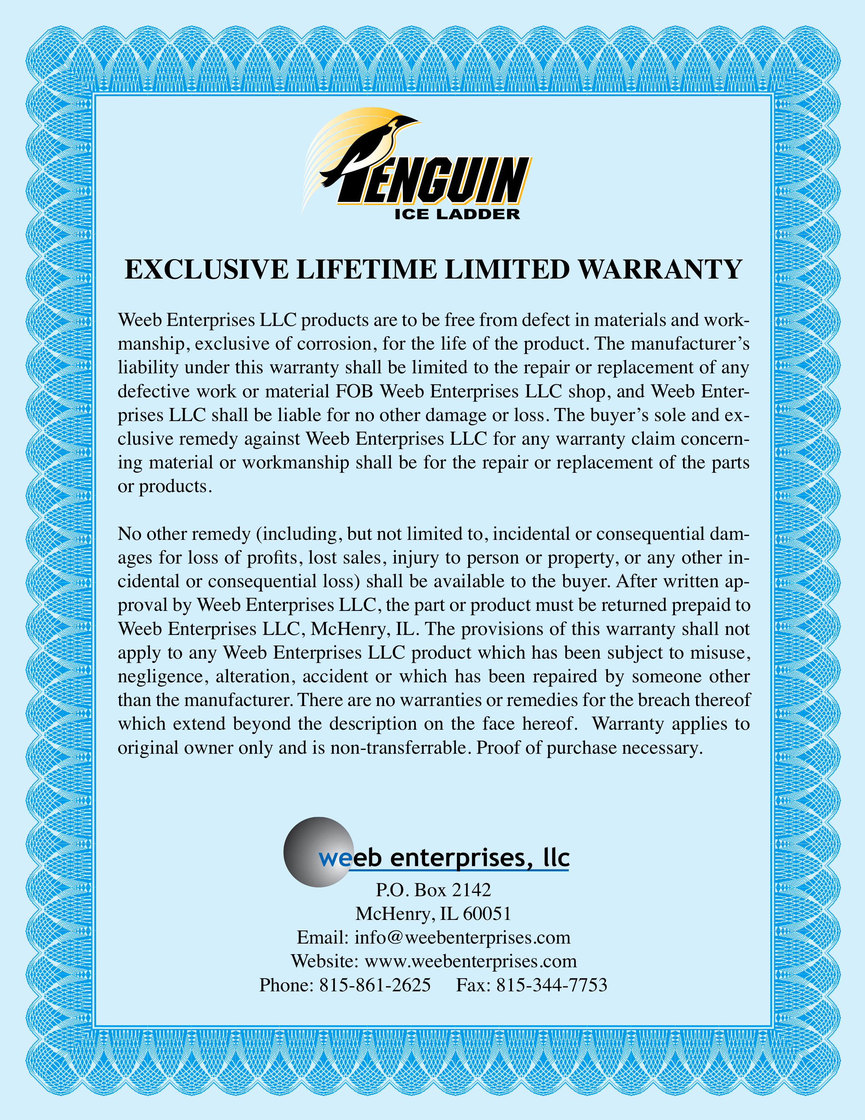
Exclusive Limited Life Time Warranty
Weeb Enterprises, LLC believes in the craftsmanship and quality of materials used in the Penguin Ice Ladder. The Penguin Ice Ladder is manufactured to precision specifications to last a lifetime. We stand behind it 100%.

Slide 58
Thank you for inquiring about the Penguin Ice Ladder. If you have any questions or comments please do not hesitate to contact us. We look forward to working with you soon. Stay safe!
Sincerely,
Chris Smith

Slide 59
Manufactured by:
Weeb Enterprises, LLC
P.O. Box 2142
McHenry, IL 60051
U.S.A.
Phone 815.861.2625
Fax 815.344.7753
Email info@weebenterprises.com
www.ICELADDER.com

